Slide 1
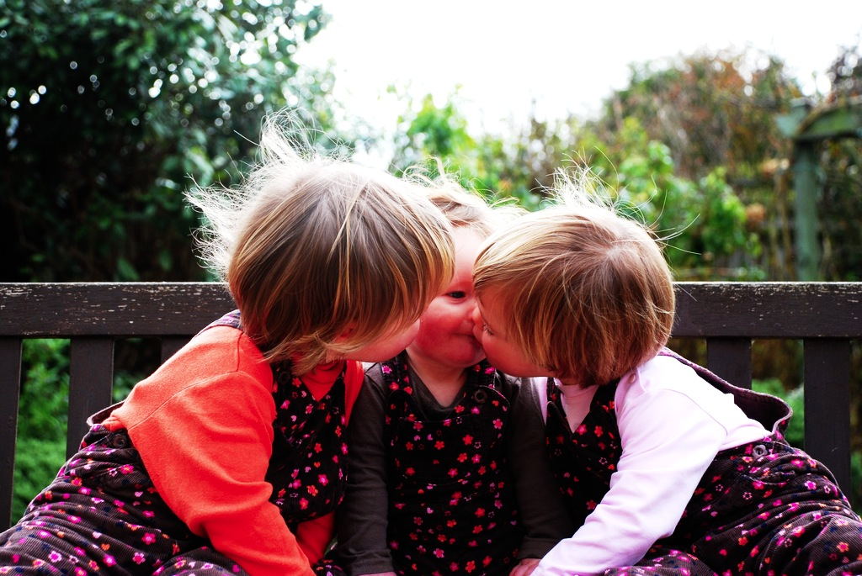

Which Joint Actions
Ground Social Cognition?

Slide 2




Notes:
Before I start ... partly to blame for what follows ...

Slide 3
Which Joint Actions
Ground Social Cognition?

Slide 4
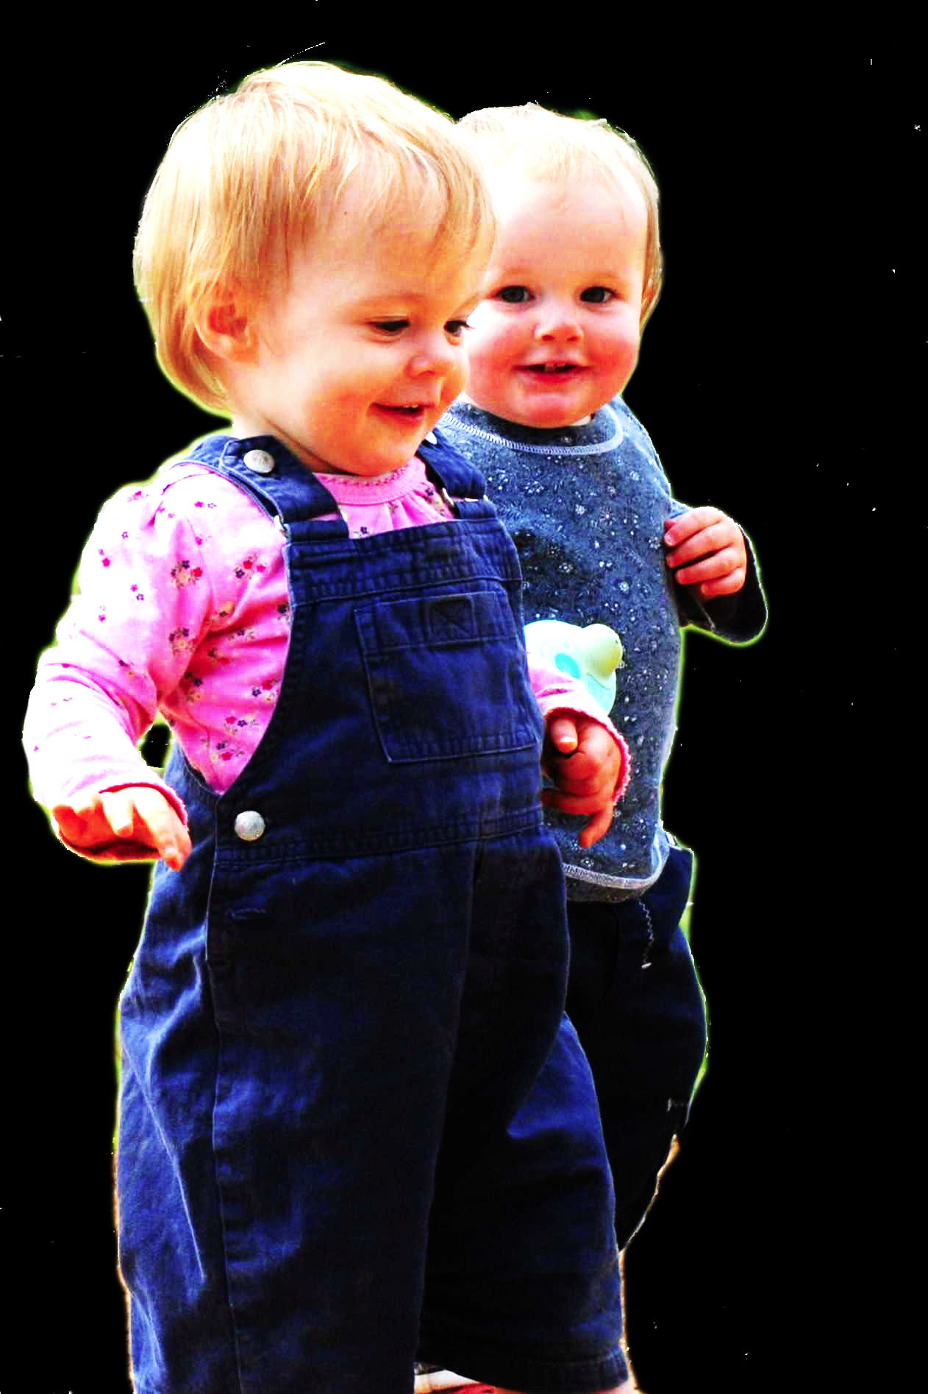
challenge
Explain the emergence, in evolution or development, of sophisticated forms of social cognition.

Slide 5
challenge
Explain the emergence, in evolution or development, of sophisticated forms of social cognition.
Representing perceptions, knowledge states and beliefs is hard, for it requires

Slide 6
challenge
Explain the emergence, in evolution or development, of sophisticated forms of social cognition.
Representing perceptions, knowledge states and beliefs is hard, for it requires
(a) conceptual sophistication
- takes years to develop
- development tied to acquisition of executive function and language
- development facilitated by training and siblings
(b) scarce cognitive resources
- attention
- working memory

Slide 7
challenge
Explain the emergence, in evolution or development, of sophisticated forms of social cognition.
Representing perceptions, knowledge states and beliefs is hard, for it requires
(a) conceptual sophistication
- takes years to develop
- development tied to acquisition of executive function and language
- development facilitated by training and siblings
(b) scarce cognitive resources
- attention
- working memory

Slide 8
challenge
Explain the emergence, in evolution or development, of sophisticated forms of social cognition.
Representing perceptions, knowledge states and beliefs is hard, for it requires
(a) conceptual sophistication
- takes years to develop
- development tied to acquisition of executive function and language
- development facilitated by training and siblings
(b) scarce cognitive resources
- attention
- working memory

Slide 9
challenge
Explain the emergence, in evolution or development, of sophisticated forms of social cognition.

Slide 10


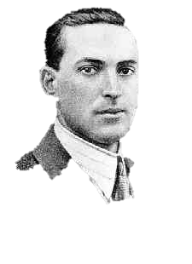
challenge
Explain the emergence, in evolution or development, of sophisticated forms of social cognition.
“the unique aspects of human cognition ... were driven by, or even constituted by, social co-operation”
(Moll & Tomasello 2007)
“perception, action, and cognition are grounded in social interaction”
(Sebanz & Knoblich 2008)

Slide 11
challenge
Explain the emergence, in evolution or development, of sophisticated forms of social cognition.
conjecture
The existence of abilities to engage in joint action partially explains how sophisticated forms of social cognition emerge in evolution or development (or both)

Slide 12
challenge
Explain the emergence, in evolution or development, of sophisticated forms of social cognition.
conjecture
The existence of abilities to engage in joint action partially explains how sophisticated forms of social cognition emerge in evolution or development (or both)

Slide 13
challenge
Explain the emergence, in evolution or development, of sophisticated forms of social cognition.
conjecture
The existence of abilities to engage in joint action partially explains how sophisticated forms of social cognition emerge in evolution or development (or both)
question
Given the conjecture, what could joint action be?

Slide 14
tidying up the toys together
(Behne et al 2005)
cooperatively pulling handles in sequence to make a dog-puppet sing
(Brownell et al 2006)
bouncing a ball on a large trampoline together
(Tomasello & Carpenter 2007)
pretending to row a boat together

Slide 15
painting a house together
(Bratman 1992)
lifting a heavy sofa together
(Velleman 1997)
preparing a hollandaise sauce together
(Searle 1990)
going to Chicago together
(Kutz 2000)
walking together
(Gilbert 1990)
tidying up the toys together
(Behne et al 2005)
cooperatively pulling handles in sequence to make a dog-puppet sing
(Brownell et al 2006)
bouncing a ball on a large trampoline together
(Tomasello & Carpenter 2007)
pretending to row a boat together

Slide 16
shared intention

Slide 17
‘I take a collective action to involve a collective [shared] intention.’
(Gilbert 2006, p. 5)

Slide 18
‘I take a collective action to involve a collective [shared] intention.’
(Gilbert 2006, p. 5)
‘The sine qua non of collaborative action is a joint goal [shared intention] and a joint commitment’
(Tomasello 2008, p. 181)

Slide 19
‘I take a collective action to involve a collective [shared] intention.’
(Gilbert 2006, p. 5)
‘The sine qua non of collaborative action is a joint goal [shared intention] and a joint commitment’
(Tomasello 2008, p. 181)
‘the key property of joint action lies in its internal component [...] in the participants’ having a “collective” or “shared” intention.’
(Alonso 2009, pp. 444-5)
‘Shared intentionality is the foundation upon which joint action is built.’
(Carpenter 2009, p. 381)

Slide 20
What is shared intention?

Slide 21
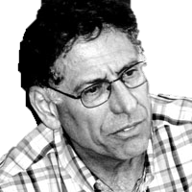
What is shared intention?

Slide 22
What is shared intention?
Functional characterisation
Substantial account

Slide 23
What is shared intention?
Functional characterisation
shared intention serves to (a) coordinate activities, (b) coordinate planning and (c) structure bargaining
Substantial account

Slide 24
What is shared intention?
Functional characterisation
shared intention serves to (a) coordinate activities, (b) coordinate planning and (c) structure bargaining
Substantial account
We have a shared intention that we J if
“1. (a) I intend that we J and (b) you intend that we J
“2. I intend that we J in accordance with and because of la, lb, and meshing subplans of la and lb; you intend [likewise] …
“3. 1 and 2 are common knowledge between us”
(Bratman 1993: View 4)

Slide 25
What is shared intention?
Functional characterisation
shared intention serves to (a) coordinate activities, (b) coordinate planning and (c) structure bargaining
Substantial account
We have a shared intention that we J if
“1. (a) I intend that we J and (b) you intend that we J
“2. I intend that we J in accordance with and because of la, lb, and meshing subplans of la and lb; you intend [likewise] …
“3. 1 and 2 are common knowledge between us”
(Bratman 1993: View 4)
{
Intentions about intentions

Slide 26
What is shared intention?
Functional characterisation
shared intention serves to (a) coordinate activities, (b) coordinate planning and (c) structure bargaining
Substantial account
We have a shared intention that we J if
“1. (a) I intend that we J and (b) you intend that we J
“2. I intend that we J in accordance with and because of la, lb, and meshing subplans of la and lb; you intend [likewise] …
“3. 1 and 2 are common knowledge between us”
(Bratman 1993: View 4)
{
Intentions about intentions
{
Knowledge of others’ knowledge of intentions about intentions

Slide 27
What is shared intention?
Functional characterisation
shared intention serves to (a) coordinate activities, (b) coordinate planning and (c) structure bargaining
Substantial account
We have a shared intention that we J if
“1. (a) I intend that we J and (b) you intend that we J
“2. I intend that we J in accordance with and because of la, lb, and meshing subplans of la and lb; you intend [likewise] …
“3. 1 and 2 are common knowledge between us”
(Bratman 1993: View 4)
{
Intentions about intentions
{
Knowledge of others’ knowledge of intentions about intentions

Slide 28
What is shared intention?
Functional characterisation
shared intention serves to (a) coordinate activities, (b) coordinate planning and (c) structure bargaining
Substantial account
We have a shared intention that we J if
“1. (a) I intend that we J and (b) you intend that we J
“2. I intend that we J in accordance with and because of la, lb, and meshing subplans of la and lb; you intend [likewise] …
“3. 1 and 2 are common knowledge between us”
(Bratman 1993: View 4)

Slide 29
What is shared intention?
Functional characterisation
shared intention serves to (a) coordinate activities, (b) coordinate planning and (c) structure bargaining
Substantial account
We have a shared intention that we J if
“1. (a) I intend that we J and (b) you intend that we J
“2. I intend that we J in accordance with and because of la, lb, and meshing subplans of la and lb; you intend [likewise] …
“3. 1 and 2 are common knowledge between us”
(Bratman 1993: View 4)
‘shared intentional agency consists, at bottom, in interconnected planning agency of the participants.’
(Bratman 2011, p. 11)

Slide 30
1. All (significant) joint actions require shared intention.
2. Shared intention requires sophisticated theory of mind cognition.
Therefore:
3. Abilities to engage in joint action could play no significant role in explaining how sophisticated theory of mind cognition emerges.

Slide 31
1. All (significant) joint actions require shared intention.
2. Shared intention requires sophisticated theory of mind cognition.
Therefore:
3. Abilities to engage in joint action could play no significant role in explaining how sophisticated theory of mind cognition emerges.
(not why)

Slide 32
challenge
1. All (significant) joint actions require shared intention.
2. Shared intention requires sophisticated theory of mind cognition.
Therefore:
3. Abilities to engage in joint action could play no significant role in explaining how sophisticated theory of mind cognition emerges.
Explain the emergence, in evolution or development, of sophisticated forms of social cognition.
conjecture
The existence of abilities to engage in joint action partially explains how sophisticated forms of social cognition emerge in evolution or development (or both)
question
Given the conjecture, what could joint action be?

Slide 33
1. All (significant) joint actions require shared intention.
2. Shared intention requires sophisticated theory of mind cognition.
Therefore:
3. Abilities to engage in joint action could play no significant role in explaining how sophisticated theory of mind cognition emerges.

Slide 34
1. All (significant) joint actions require shared intention.
2. Shared intention requires sophisticated theory of mind cognition.
Therefore:
3. Abilities to engage in joint action could play no significant role in explaining how sophisticated theory of mind cognition emerges.

Slide 35
Joint action:
an action with two or more agents (Ludwig 2007)

Slide 36
Joint action:
an action with two or more agents (Ludwig 2007)

Slide 37
Joint action:
an action with two or more agents (Ludwig 2007)
‘our primitive actions, the ones we do not by doing something else, ... these are all the actions there are.’ (Davidson 1971, p. 59).

Slide 38
Joint action:
an action with two or more agents (Ludwig 2007)
‘our primitive actions, the ones we do not by doing something else, ... these are all the actions there are.’ (Davidson 1971, p. 59).
move fingers
unlock door
turn key

Slide 39
Joint action:
an action with two or more agents (Ludwig 2007)
‘our primitive actions, the ones we do not by doing something else, ... these are all the actions there are.’ (Davidson 1971, p. 59).
move fingers
unlock door
turn key

Slide 40
Joint action:
an action with two or more agents (Ludwig 2007)
‘our primitive actions, the ones we do not by doing something else, ... these are all the actions there are.’ (Davidson 1971, p. 59).
move fingers
unlock door
turn key

Slide 41
Joint action:
an action with two or more agents (Ludwig 2007)
‘our primitive actions, the ones we do not by doing something else, ... these are all the actions there are.’ (Davidson 1971, p. 59).
tidying up the toys together
(Behne et al 2005)
cooperatively pulling handles in sequence to make a dog-puppet sing
(Brownell et al 2006)
bouncing a ball on a large trampoline together
(Tomasello & Carpenter 2007)
pretending to row a boat together
move fingers
unlock door
turn key

Slide 42
Joint action:
an action with two or more agents (Ludwig 2007)
‘our primitive actions, the ones we do not by doing something else, ... these are all the actions there are.’ (Davidson 1971, p. 59).
tidying up the toys together
(Behne et al 2005)
cooperatively pulling handles in sequence to make a dog-puppet sing
(Brownell et al 2006)
bouncing a ball on a large trampoline together
(Tomasello & Carpenter 2007)
pretending to row a boat together
move fingers
unlock door
turn key

Slide 43
Joint action:
an action with two or more agents (Ludwig 2007)
tidying up the toys together
(Behne et al 2005)
cooperatively pulling handles in sequence to make a dog-puppet sing
(Brownell et al 2006)
bouncing a ball on a large trampoline together
(Tomasello & Carpenter 2007)
pretending to row a boat together
my pulling
dog’s singing
your pulling
We make the dog sing

Slide 44
Joint action:
an action with two or more agents (Ludwig 2007)
tidying up the toys together
(Behne et al 2005)
cooperatively pulling handles in sequence to make a dog-puppet sing
(Brownell et al 2006)
bouncing a ball on a large trampoline together
(Tomasello & Carpenter 2007)
pretending to row a boat together
my pulling
dog’s singing
your pulling
We make the dog sing

Slide 45
1
Joint action:
an action with two or more agents (Ludwig 2007)
Bodily movements ‘are all the actions there are’ (Davidson 1971, p. 59)
In supposedly paradigm cases of joint action, there are no bodily movements with more than one agent.
Therefore:
Supposedly paradigm cases are not joint actions.
tidying up the toys together
(Behne et al 2005)
cooperatively pulling handles in sequence to make a dog-puppet sing
(Brownell et al 2006)
bouncing a ball on a large trampoline together
(Tomasello & Carpenter 2007)
pretending to row a boat together
2
3
4

Slide 46
1
too narrow
Joint action:
an action with two or more agents (Ludwig 2007)
Bodily movements ‘are all the actions there are’ (Davidson 1971, p. 59)
In supposedly paradigm cases of joint action, there are no bodily movements with more than one agent.
Therefore:
Supposedly paradigm cases are not joint actions.
tidying up the toys together
(Behne et al 2005)
cooperatively pulling handles in sequence to make a dog-puppet sing
(Brownell et al 2006)
bouncing a ball on a large trampoline together
(Tomasello & Carpenter 2007)
pretending to row a boat together
2
3
4

Slide 47
?
1
too narrow
Joint action:
an action with two or more agents (Ludwig 2007)
Bodily movements ‘are all the actions there are’ (Davidson 1971, p. 59)
In supposedly paradigm cases of joint action, there are no bodily movements with more than one agent.
Therefore:
Supposedly paradigm cases are not joint actions.
tidying up the toys together
(Behne et al 2005)
cooperatively pulling handles in sequence to make a dog-puppet sing
(Brownell et al 2006)
bouncing a ball on a large trampoline together
(Tomasello & Carpenter 2007)
pretending to row a boat together
2
3
4

Slide 48
?
1
too narrow
Joint action:
an action with two or more agents (Ludwig 2007)
Bodily movements ‘are all the actions there are’ (Davidson 1971, p. 59)
In supposedly paradigm cases of joint action, there are no bodily movements with more than one agent.
Therefore:
Supposedly paradigm cases are not joint actions.
tidying up the toys together
(Behne et al 2005)
cooperatively pulling handles in sequence to make a dog-puppet sing
(Brownell et al 2006)
bouncing a ball on a large trampoline together
(Tomasello & Carpenter 2007)
pretending to row a boat together
2
3
4
Notes:
we could reject this ... but I want to pursue a different approach

Slide 49
1
too narrow
Joint action:
an action with two or more agents (Ludwig 2007)
Bodily movements ‘are all the actions there are’ (Davidson 1971, p. 59)
In supposedly paradigm cases of joint action, there are no bodily movements with more than one agent.
Therefore:
Supposedly paradigm cases are not joint actions.
tidying up the toys together
(Behne et al 2005)
cooperatively pulling handles in sequence to make a dog-puppet sing
(Brownell et al 2006)
bouncing a ball on a large trampoline together
(Tomasello & Carpenter 2007)
pretending to row a boat together
2
3
4
Notes:
we could reject this ... but I want to pursue a different approach

Slide 50
Joint action:
an action with two or more agents (Ludwig 2007)

Slide 51
Joint action:
an action event with two or more agents (Ludwig 2007)

Slide 52
Grounding
events D₁, ... D_{n} ground E, if:
D₁, ... D_{n} and E occur;
D₁, ... D_{n} are each (perhaps improper) parts of E; and
every event that is a proper part of E but does not overlap D₁,...D_{n} is caused by some or all of D₁, ... D_{n}.
Agency
For an individual to be among the agents of an event is for there to be actions a₁, ... a_{n} which ground this event where the individual is an agent of one or more of these actions.
(Adapted from Pietroski 1998)

Slide 53
Joint action:
an action event with two or more agents (Ludwig 2007)

Slide 54
Joint action:
an action event with two or more agents (Ludwig 2007)
tidying up the toys together
(Behne et al 2005)
cooperatively pulling handles in sequence to make a dog-puppet sing
(Brownell et al 2006)
bouncing a ball on a large trampoline together
(Tomasello & Carpenter 2007)
pretending to row a boat together
my pulling
dog’s singing
your pulling
We make the dog sing

Slide 55
Joint action:
an action event with two or more agents (Ludwig 2007)
tidying up the toys together
(Behne et al 2005)
cooperatively pulling handles in sequence to make a dog-puppet sing
(Brownell et al 2006)
bouncing a ball on a large trampoline together
(Tomasello & Carpenter 2007)
pretending to row a boat together

Slide 56
Joint action:
an action event with two or more agents (Ludwig 2007)
tidying up the toys together
(Behne et al 2005)
cooperatively pulling handles in sequence to make a dog-puppet sing
(Brownell et al 2006)
bouncing a ball on a large trampoline together
(Tomasello & Carpenter 2007)
pretending to row a boat together
Nora’s shooting
Fred’s death
Olive’s shooting
Fred’s killing

Slide 57
too broad
Joint action:
an action event with two or more agents (Ludwig 2007)
tidying up the toys together
(Behne et al 2005)
cooperatively pulling handles in sequence to make a dog-puppet sing
(Brownell et al 2006)
bouncing a ball on a large trampoline together
(Tomasello & Carpenter 2007)
pretending to row a boat together
Nora’s shooting
Fred’s death
Olive’s shooting
Fred’s killing

Slide 58
too broad
Joint action:
an action event with two or more agents (Ludwig 2007)
tidying up the toys together
(Behne et al 2005)
cooperatively pulling handles in sequence to make a dog-puppet sing
(Brownell et al 2006)
bouncing a ball on a large trampoline together
(Tomasello & Carpenter 2007)
pretending to row a boat together
Nora’s shooting
Fred’s death
Olive’s shooting
Fred’s killing

Slide 59
Goal-directed joint action: an event with two or more agents which, taken as a whole, is directed to a goal.
tidying up the toys together
(Behne et al 2005)
cooperatively pulling handles in sequence to make a dog-puppet sing
(Brownell et al 2006)
bouncing a ball on a large trampoline together
(Tomasello & Carpenter 2007)
pretending to row a boat together
Nora’s shooting
Fred’s death
Olive’s shooting
Fred’s killing

Slide 60
Goal-directed joint action: an event with two or more agents which, taken as a whole, is directed to a goal.
tidying up the toys together
(Behne et al 2005)
cooperatively pulling handles in sequence to make a dog-puppet sing
(Brownell et al 2006)
bouncing a ball on a large trampoline together
(Tomasello & Carpenter 2007)
pretending to row a boat together
cooperatively pulling handles in sequence to make a dog-puppet sing
(Brownell et al 2006)
my pulling
dog’s singing
your pulling
We make the dog sing

Slide 61
Goal-directed joint action: an event with two or more agents which, taken as a whole, is directed to a goal.
out
out
act
out
act
out

Slide 62
Goal-directed joint action: an event with two or more agents which, taken as a whole, is directed to a goal.
out
out
act
represents
coordinates
out
act
shared intention
out

Slide 63
Goal-directed joint action: an event with two or more agents which, taken as a whole, is directed to a goal.
???
out
out
act
represents
coordinates
out
act
shared intention
out

Slide 64
Detour
Goals are not intentions

Slide 65
What is the relation between an action and the goal (or goals) to which it is directed?
out
out
act
out
out

Slide 66
What is the relation between an action and the goal (or goals) to which it is directed?
out
out
act
out
out

Slide 67
What is the relation between an action and the goal (or goals) to which it is directed?
out
out
act
out
intention or other goal-state
out

Slide 68
What is the relation between an action and the goal (or goals) to which it is directed?
teleological function
out
out
act
out
intention or other goal-state
out

Slide 69
(i) in the past, actions of this type have caused outcomes of this type; (ii) this action happens now in part because (i).
What is the relation between an action and the goal (or goals) to which it is directed?
teleological function
out
out
act
out
intention or other goal-state
out

Slide 70
(i) in the past, actions of this type have caused outcomes of this type; (ii) this action happens now in part because (i).
What is the relation between an action and the goal (or goals) to which it is directed?
teleological function
out
out
act
out
intention or other goal-state
It is possible to represent goal-directed actions without representing intentions.
out

Slide 71
End Detour

Slide 72
Goal-directed joint action: an event with two or more agents which, taken as a whole, is directed to a goal.
???
out
out
act
represents
coordinates
out
act
shared intention
out

Slide 73
Goal-directed joint action: an event with two or more agents which, taken as a whole, is directed to a goal.
G is a distributive goal: it is an outcome to which each agent’s activities are individually directed and it is possible that: all agents succeed relative to this outcome.

Slide 74
Goal-directed joint action: an event with two or more agents which, taken as a whole, is directed to a goal.
G is a distributive goal: it is an outcome to which each agent’s activities are individually directed and it is possible that: all agents succeed relative to this outcome.
G is a collective goal
(a) it is a distributive goal;
(b) the agents’ activities are coordinated; and
(c) coordination of this type would normally facilitate occurrences of outcomes of this type.

Slide 75
Goal-directed joint action: an event with two or more agents which, taken as a whole, is directed to a goal.
G is a distributive goal: it is an outcome to which each agent’s activities are individually directed and it is possible that: all agents succeed relative to this outcome.
G is a collective goal
(a) it is a distributive goal;
(b) the agents’ activities are coordinated; and
(c) coordination of this type would normally facilitate occurrences of outcomes of this type.

Slide 76
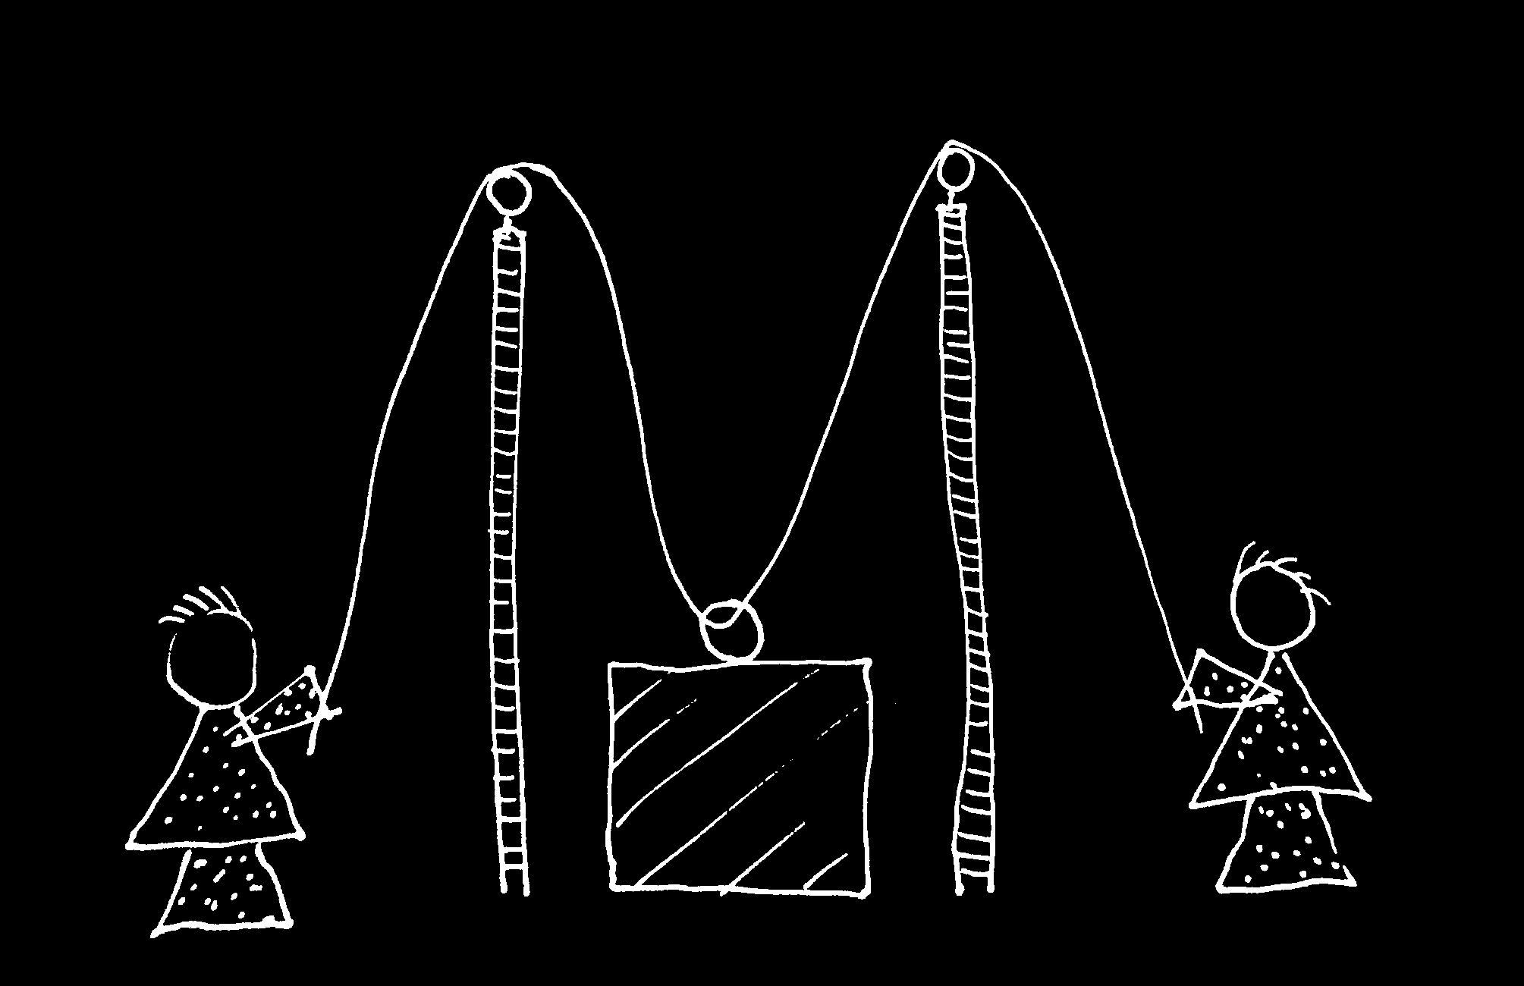

Slide 77
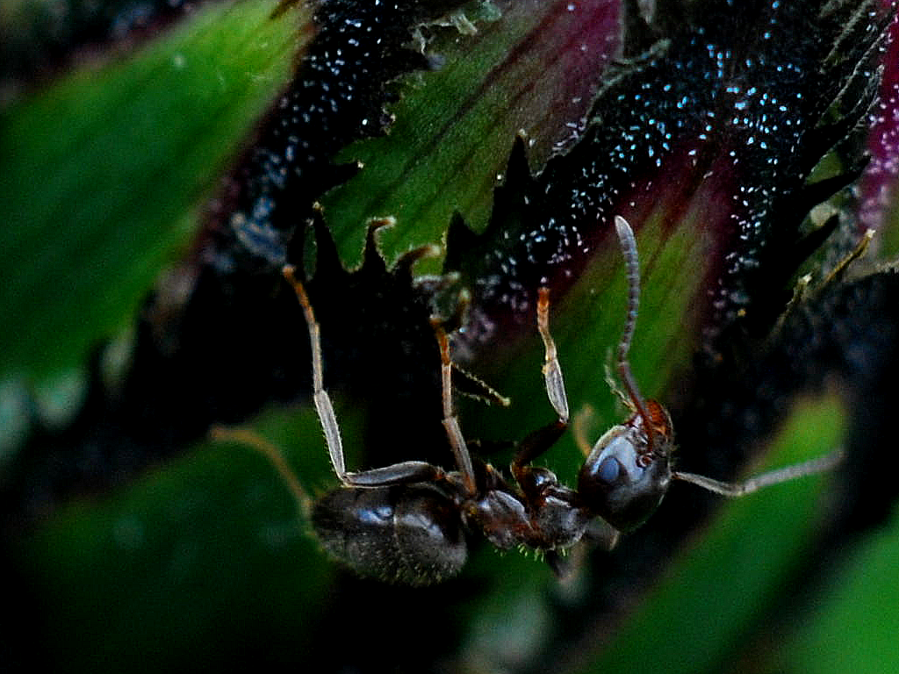

Slide 78
sting
sting
sting
sting
sting
death of fly
sting
sting
sting

Slide 79
Goal-directed joint action: an event with two or more agents which, taken as a whole, is directed to a goal.
G is a distributive goal: it is an outcome to which each agent’s activities are individually directed and it is possible that: all agents succeed relative to this outcome.
G is a collective goal
(a) it is a distributive goal;
(b) the agents’ activities are coordinated; and
(c) coordination of this type would normally facilitate occurrences of outcomes of this type.

Slide 80
Goal-directed joint action: an event with two or more agents which, taken as a whole, is directed to a goal.
G is a distributive goal: it is an outcome to which each agent’s activities are individually directed and it is possible that: all agents succeed relative to this outcome.
G is a shared goal
G is a collective goal
(a) it is a distributive goal;
(b) the agents’ activities are coordinated; and
(c) coordination of this type would normally facilitate occurrences of outcomes of this type.
Each agent expects each of the other agents to perform activities directed to the goal.
Each agent expects the goal to occur as a common effect of all their goal-directed actions.

Slide 81
Joint action:
an action event with two or more agents (Ludwig 2007)

Slide 82
challenge
Explain the emergence, in evolution or development, of sophisticated forms of social cognition.
conjecture
The existence of abilities to engage in joint action partially explains how sophisticated forms of social cognition emerge in evolution or development (or both)
question
Given the conjecture, what could joint action be?

Slide 83
Goal-directed joint action: an event with two or more agents which, taken as a whole, is directed to a goal.
G is a distributive goal: it is an outcome to which each agent’s activities are individually directed and it is possible that: all agents succeed relative to this outcome.
G is a shared goal
G is a collective goal
(a) it is a distributive goal;
(b) the agents’ activities are coordinated; and
(c) coordination of this type would normally facilitate occurrences of outcomes of this type.
Each agent expects each of the other agents to perform activities directed to the goal.
Each agent expects the goal to occur as a common effect of all their goal-directed actions.

Slide 84


Slide 85

joint action &
knowing
others’
minds
Notes:
This is an overview of the project and its aims

Slide 86
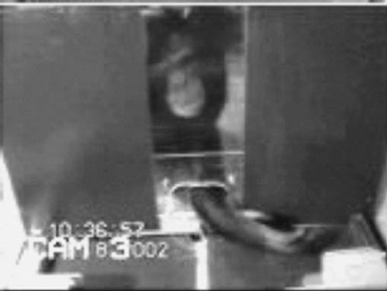
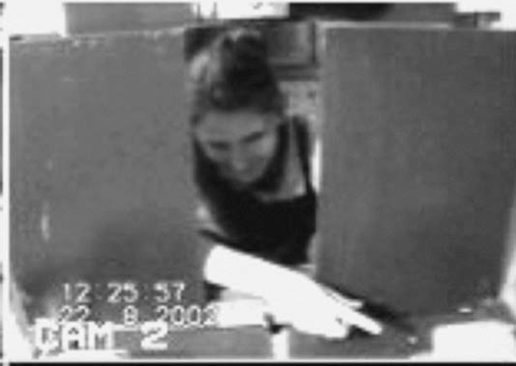
failed reach
point
source: Hare & Tomasello (2004)
Notes:
this illustrates problem of identifying particular goals of action

Slide 87
The problem of opaque means

Slide 88
The problem of false belief

Slide 89
your-goal-is-my-goal

Slide 90
your-goal-is-my-goal
1. We are about to engage in some joint action* or other
2. I am not about to change my goal.
Therefore:
3. Your actions also will be directed to this goal.
[*in at least the minimal sense associated with distributive goals]

Slide 91
failed reach
point
source: Hare & Tomasello (2004)

Slide 92
failed reach
point
source: Hare & Tomasello (2004)
“to understand pointing, the subject needs to understand more than the individual goal-directed behaviour. She needs to understand that ... the other attempts to communicate to her ... and ... the communicative intention behind the gesture”
(Moll & Tomsello 2007)

Slide 93
failed reach
point
source: Hare & Tomasello (2004)
“to understand pointing, the subject needs to understand more than the individual goal-directed behaviour. She needs to understand that ... the other attempts to communicate to her ... and ... the communicative intention behind the gesture”
(Moll & Tomsello 2007)

Slide 94
Csibra’s ‘two stances’:
Teleological and referential action interpretation ‘rely on different kinds of action understanding’
These are initially two distinct ‘action interpretation systems’ and they come together later in development
Csibra (2003, p. 456)

Slide 95
minimal theory of mind cognition
joint action (ability to share goals)
understanding communicative intent
other stuff
communication by language
other stuff
full-blown theory of mind cognition

Slide 97
Joint action:
an event with two or more agents (Ludwig 2007)
Goal-directed joint action:
a joint action which, taken as a whole, is directed to a goal
Nora’s shooting
Fred’s death
Olive’s shooting
Fred’s killing

Slide 98
What is the relation between an action and the goal (or goals) to which it is directed?

Slide 99
What is the relation between an action and the goal (or goals) to which it is directed?

Slide 100
What is the relation between an action and the goal (or goals) to which it is directed?
out
out
act
out
out

Slide 101
What is the relation between an action and the goal (or goals) to which it is directed?
out
out
act
(goal)
out
out

Slide 102
What is the relation between an action and the goal (or goals) to which it is directed?
out
out
act
represents
coordinates
(goal)
out
intention or other goal-state
out

Slide 103
What is the relation between an action and the goal (or goals) to which it is directed?
teleological function
out
out
act
represents
coordinates
out
intention or other goal-state
out

Slide 104
What is the relation between an action and the goal (or goals) to which it is directed?
teleological function
out
out
act
represents
coordinates
out
intention or other goal-state
It is possible to represent goal-directed actions without representing intentions.
out

Slide 105
out
out
act
out
out

Slide 106
Goal-directed joint action: an event with two or more agents which, taken as a whole, is directed to a goal.
out
out
act
out
out

Slide 108
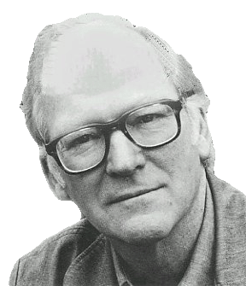
“We are stuck with our two main ways of describing and explaining things, one which treats objects and events as mindless, and the other which treats objects and events as having propositional attitudes. I see no way of bridging the gap by introducing an intermediate vocabulary.”
(Davidson 2003: 697)

Slide 109
“We are stuck with our two main ways of describing and explaining things, one which treats objects and events as mindless, and the other which treats objects and events as having propositional attitudes. I see no way of bridging the gap by introducing an intermediate vocabulary.”
(Davidson 2003: 697)

Slide 111

appendix
What could infants, chimps and scrub-jays represent that would enable them, within limits, to track others’ perceptions, knowledge, beliefs and other propositional attitudes?

Slide 112




Intentional relation
e.g. She is interested in that chocolate
e.g. She is smiling at me
Propositional attitude
e.g. She believes that the chocolate is in that cupboard

Slide 113

Your field = a set of objects related to you by proximity, orientation, lighting and other factors
You encounter an object = it is in your field
You register an object at a location = you most recently encountered the object at that location

Slide 114
Your field = a set of objects related to you by proximity, orientation, lighting and other factors
You encounter an object = it is in your field
You register an object at a location = you most recently encountered the object at that location
proximity
orientation
lighting
barriers
trajectory

Slide 115
Your field = a set of objects related to you by proximity, orientation, lighting and other factors
You encounter an object = it is in your field
You register an object at a location = you most recently encountered the object at that location
proximity
orientation
lighting
barriers
trajectory

Slide 116
Your field = a set of objects related to you by proximity, orientation, lighting and other factors
You encounter an object = it is in your field
You register an object at a location = you most recently encountered the object at that location
Principle 1: one can’t goal-directedly act on an object unless one has encountered it.
Principle 2: correct registration is a condition of successful action.
Principle 3: when an agent performs a goal-directed action and the goal specifies an object, the agent will act as if the object were actually in the location she registers it at.
proximity
orientation
lighting
barriers
trajectory

Slide 117
Your field = a set of objects related to you by proximity, orientation, lighting and other factors
You encounter an object = it is in your field
You register an object at a location = you most recently encountered the object at that location
Principle 1: one can’t goal-directedly act on an object unless one has encountered it.
Principle 2: correct registration is a condition of successful action.
Principle 3: when an agent performs a goal-directed action and the goal specifies an object, the agent will act as if the object were actually in the location she registers it at.
proximity
orientation
lighting
barriers
trajectory

Slide 118
Your field = a set of objects related to you by proximity, orientation, lighting and other factors
You encounter an object = it is in your field
You register an object at a location = you most recently encountered the object at that location
Principle 1: one can’t goal-directedly act on an object unless one has encountered it.
Principle 2: correct registration is a condition of successful action.
Principle 3: when an agent performs a goal-directed action and the goal specifies an object, the agent will act as if the object were actually in the location she registers it at.
proximity
orientation
lighting
barriers
trajectory

Slide 119
Your field = a set of objects related to you by proximity, orientation, lighting and other factors
You encounter an object = it is in your field
You register an object at a location = you most recently encountered the object at that location
Principle 1: one can’t goal-directedly act on an object unless one has encountered it.
Principle 2: correct registration is a condition of successful action.
Principle 3
proximity
orientation
lighting
barriers
trajectory

Slide 120
Your field = a set of objects related to you by proximity, orientation, lighting and other factors
You encounter an object = it is in your field
You register an object at a location = you most recently encountered the object at that location
Principle 1: one can’t goal-directedly act on an object unless one has encountered it.
Principle 2: correct registration is a condition of successful action.
Principle 3: when an agent performs a goal-directed action and the goal specifies an object, the agent will act as if the object were actually in the location she registers it at.
proximity
orientation
lighting
barriers
trajectory

Slide 121

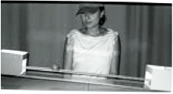
source Träuble, Marinovic, & Pauen (2010)

Slide 122
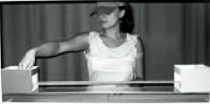
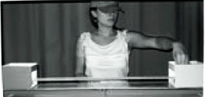
source Träuble, Marinovic, & Pauen (2010)

Slide 123
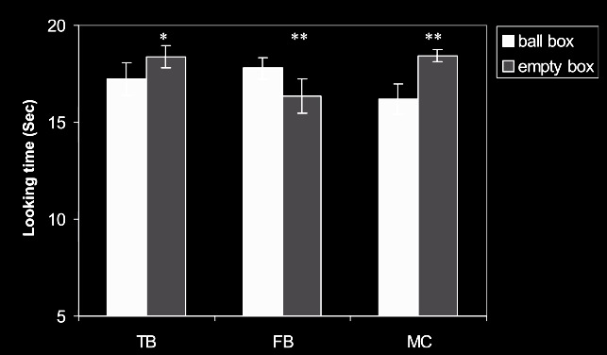
source Träuble, Marinovic, & Pauen (2010)

Slide 124
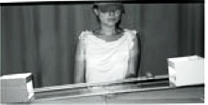
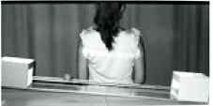
source Träuble, Marinovic, & Pauen (2010)

Slide 125
source Träuble, Marinovic, & Pauen (2010)

Slide 126
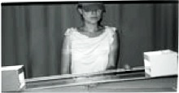
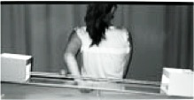
source Träuble, Marinovic, & Pauen (2010)

Slide 127
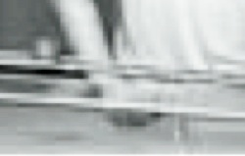
source Träuble, Marinovic, & Pauen (2010)

Slide 128
source Träuble, Marinovic, & Pauen (2010)

Slide 129
Your field = a set of objects related to you by proximity, orientation, lighting and other factors
You encounter an object = it is in your field
You register an object at a location = you most recently encountered the object at that location
Principle 1: one can’t goal-directedly act on an object unless one has encountered it.
Principle 2: correct registration is a condition of successful action.
Principle 3: when an agent performs a goal-directed action and the goal specifies an object, the agent will act as if the object were actually in the location she registers it at.
proximity
orientation
lighting
barriers
trajectory

Slide 130
Your field = a set of objects related to you by proximity, orientation, lighting and other factors
You encounter an object = it is in your field
You register an object at a location = you most recently encountered the object at that location
Principle 1: one can’t goal-directedly act on an object unless one has encountered it.
Principle 2: correct registration is a condition of successful action.
Principle 3: when an agent performs a goal-directed action and the goal specifies an object, the agent will act as if the object were actually in the location she registers it at.
proximity
orientation
lighting
barriers
trajectory

Slide 131
Principle 2: correct registration is a condition of successful action.
source Träuble, Marinovic, & Pauen (2010)

Slide 132
signature limits

Slide 133
1. Charly is Samantha
2. Mitch believes that Charly is in Baltimore
3. Mitch believes that Samantha is in Baltimore
(1) & (2) ⇒ (3)

Slide 134
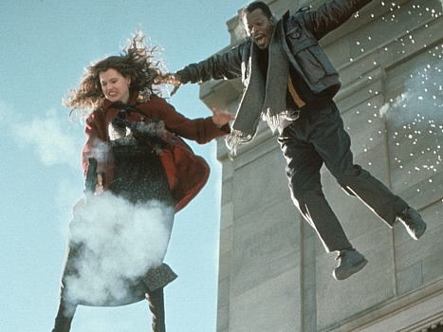
1. Charly is Samantha
2. Mitch believes that Charly is in Baltimore
3. Mitch believes that Samantha is in Baltimore
(1) & (2) ⇒ (3)

Slide 135
1. Charly is Samantha
2. Mitch believes that Charly is in Baltimore
3. Mitch believes that Samantha is in Baltimore
(1) & (2) ⇒ (3)
4. Mitch registers <Charly, Baltimore>
5. Mitch registers <Samantha, Baltimore>
(1) & (4) ⇒ (5)

Slide 136
False belief about location
False belief about identity
Subjects represent registration
Subjects represent beliefs
pass
fail
pass
pass

Slide 137
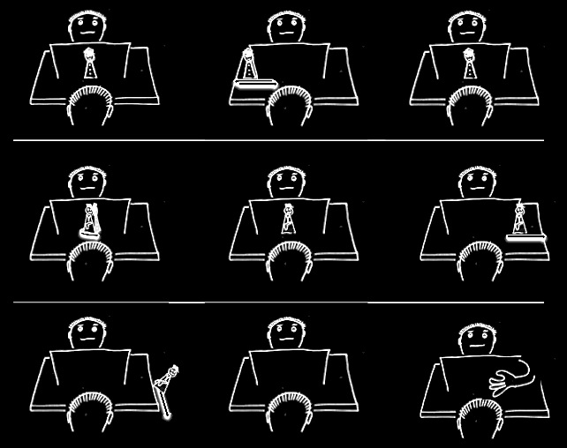

Slide 142
Which Joint Actions
Ground Social Cognition?
s.butterfill@warwick.ac.uk

Slide 143
Theory of mind abilities are widespread

Slide 144
Theory of mind abilities are widespread
18-month-olds point to inform, and predict actions based on false beliefs
(Liszkowski et al 2006)
(Onishi & Baillargeon 2005; Southgate et al 2007)

Slide 145
Theory of mind abilities are widespread
18-month-olds point to inform, and predict actions based on false beliefs
Scrub-jays selectively re-cache their food in ways that deprive competitors of knowledge of its location
(Liszkowski et al 2006)
(Onishi & Baillargeon 2005; Southgate et al 2007)
(Clayton, Dally & Emery 2007)

Slide 146
Theory of mind abilities are widespread
18-month-olds point to inform, and predict actions based on false beliefs
Scrub-jays selectively re-cache their food in ways that deprive competitors of knowledge of its location
Chimpanzees conceal their approach from a competitor’s view, and act in ways that are optimal given what another has seen
(Liszkowski et al 2006)
(Onishi & Baillargeon 2005; Southgate et al 2007)
(Clayton, Dally & Emery 2007)
(Hare, Call & Tomasello 2006)
(Hare, Call & Tomasello 2001)

Slide 147
Theory of mind abilities are widespread
18-month-olds point to inform, and predict actions based on false beliefs
Scrub-jays selectively re-cache their food in ways that deprive competitors of knowledge of its location
Chimpanzees conceal their approach from a competitor’s view, and act in ways that are optimal given what another has seen
(Liszkowski et al 2006)
(Onishi & Baillargeon 2005; Southgate et al 2007)
(Clayton, Dally & Emery 2007)
(Hare, Call & Tomasello 2006)
(Hare, Call & Tomasello 2001)

Slide 148
Theory of mind abilities are widespread
18-month-olds point to inform, and predict actions based on false beliefs
Scrub-jays selectively re-cache their food in ways that deprive competitors of knowledge of its location
Chimpanzees conceal their approach from a competitor’s view, and act in ways that are optimal given what another has seen
(Liszkowski et al 2006)
(Onishi & Baillargeon 2005; Southgate et al 2007)
(Clayton, Dally & Emery 2007)
(Hare, Call & Tomasello 2006)
(Hare, Call & Tomasello 2001)

Slide 149
Theory of mind abilities are widespread
18-month-olds point to inform, and predict actions based on false beliefs
Scrub-jays selectively re-cache their food in ways that deprive competitors of knowledge of its location
Chimpanzees conceal their approach from a competitor’s view, and act in ways that are optimal given what another has seen
(Liszkowski et al 2006)
(Onishi & Baillargeon 2005; Southgate et al 2007)
What doinfants, chimps and scrub-jays represent that enables them, within limits, to track others’ perceptions, knowledge, beliefs and other propositional attitudes?
(Clayton, Dally & Emery 2007)
(Hare, Call & Tomasello 2006)
(Hare, Call & Tomasello 2001)

Slide 150
Theory of mind abilities are widespread
18-month-olds point to inform, and predict actions based on false beliefs
Scrub-jays selectively re-cache their food in ways that deprive competitors of knowledge of its location
Chimpanzees conceal their approach from a competitor’s view, and act in ways that are optimal given what another has seen
Representing perceptions, knowledge states and beliefs is hard

Slide 151
Theory of mind abilities are widespread
18-month-olds point to inform, and predict actions based on false beliefs
Scrub-jays selectively re-cache their food in ways that deprive competitors of knowledge of its location
Chimpanzees conceal their approach from a competitor’s view, and act in ways that are optimal given what another has seen
Representing perceptions, knowledge states and beliefs is hard, for it requires
(a) conceptual sophistication
- takes years to develop
- development tied to acquisition of executive function and language
- development facilitated by training and siblings

Slide 152
Theory of mind abilities are widespread
18-month-olds point to inform, and predict actions based on false beliefs
Scrub-jays selectively re-cache their food in ways that deprive competitors of knowledge of its location
Chimpanzees conceal their approach from a competitor’s view, and act in ways that are optimal given what another has seen
Representing perceptions, knowledge states and beliefs is hard, for it requires
(a) conceptual sophistication
- takes years to develop
- development tied to acquisition of executive function and language
- development facilitated by training and siblings
(b) scarce cognitive resources
- attention
- working memory

Slide 153
Theory of mind abilities are widespread
18-month-olds point to inform, and predict actions based on false beliefs
Scrub-jays selectively re-cache their food in ways that deprive competitors of knowledge of its location
Chimpanzees conceal their approach from a competitor’s view, and act in ways that are optimal given what another has seen
Representing perceptions, knowledge states and beliefs is hard, for it requires
(a) conceptual sophistication
- takes years to develop
- development tied to acquisition of executive function and language
- development facilitated by training and siblings
(b) scarce cognitive resources
- attention
- working memory

